Slide 1
Metashop
the ultimate shopping tool

Slide 2
Online Shopping Experience
High fraud rates continue to plague electronic commerce Web sites, with criminals expected to steal $2.6 billion (about 2% of sales) from online merchants this year, according to a new survey from CyberSource Corp.
A whopping 83% percent of respondents polled indicated that online product evaluations and reviews had at least some level of influence on their purchasing decisions. 70% of respondents said they seek out information online for a particular brand of goods and services. (Opinion Research Corporation, an infoGROUP company, July 2008)

Slide 3
Who would use this?
in 2005 holiday season online merchants attracted 27% of all spending according to Nielsen//Net ratings
34% of consumers shop online before they ever get to the store, while 39% go directly to a retailer's Web site without any prior online research

Slide 4
Solution
A shopping website that crawls for store reviews, user reviews and expert reviews
Use algorithms to create overall ratings based on both user and expert reviews
Feature highly-praised specialized merchants
Integrate deals
77% of online shoppers use reviews and ratings when purchasing. (Jupiter Research, August 2006)

Slide 5
$$$
Producers & Merchants
Pay Per Click (PPC) – banners of products
Pay Per Sale or Lead – leading a customer to buy a product from a store

Slide 6
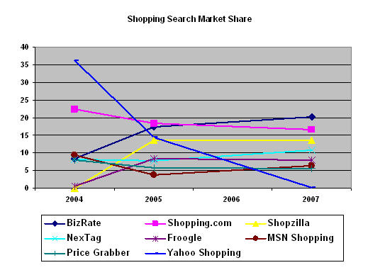
Competitors
The top 3 independents takeover the “Big 3”

Slide 7
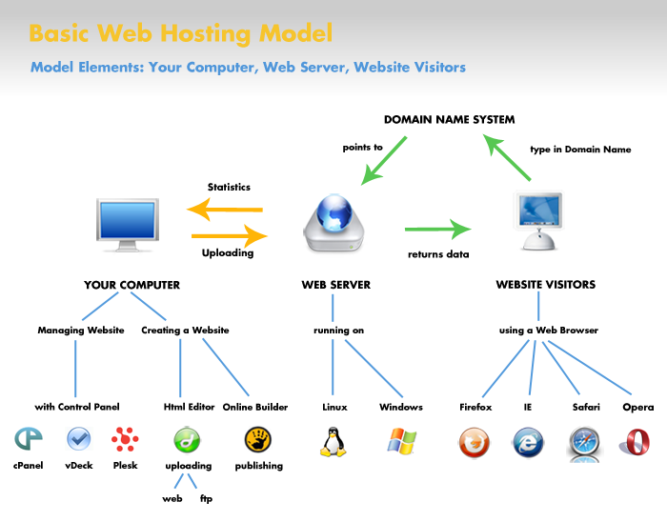

Slide 8
Benefits
Lower the chance of being scammed
Heighten chance of being happy with the product you have purchased
Find stores you can trust and feel confident in
Spend less time researching and more time buying ☺

Slide 9
Questions?

Slide 10
References
Slides 2 & 5
http://www.bazaarvoice.com/industryStats.html
Slide 3
http://www.msnbc.msn.com/id/6463545/
Slide 4
http://www.ocf.berkeley.edu/~rls/statistics.index.html
Slide 7
http://searchengineland.com/070504-105037.php

